Slide 1

COMS 1920: Explorations in Computing Research I
PROJECT TITLE: An empirical study of predictive uncertainty under the right to be forgotten
Varsha Ravivenkatesh, Computer Science, Sophomore
Neal Sharma, Computer Science, Sophomore
Raghav Kashyap, Software Engineering, Junior
This work is partially supported by the National Science Foundation under Grant No. 2152117. Any opinions, findings, and conclusions or recommendations expressed in this material are those of the author(s) and do not necessarily reflect the views of the National Science Foundation.
Notes:
The goal is to have this presentation serve as your portfolio, which you can show to a professor or others.
The acknowledgment to the National Science Foundation as some mentors are partially supported by the National Science Foundation through the Dependable-Data-Driven Discovery (D4) project.
Instruction:
Replace < … > with your own information.
1. Name your own project title.
2. Put your full name and the major you are in, and year in the major, such as first, second, or third year.

Slide 2
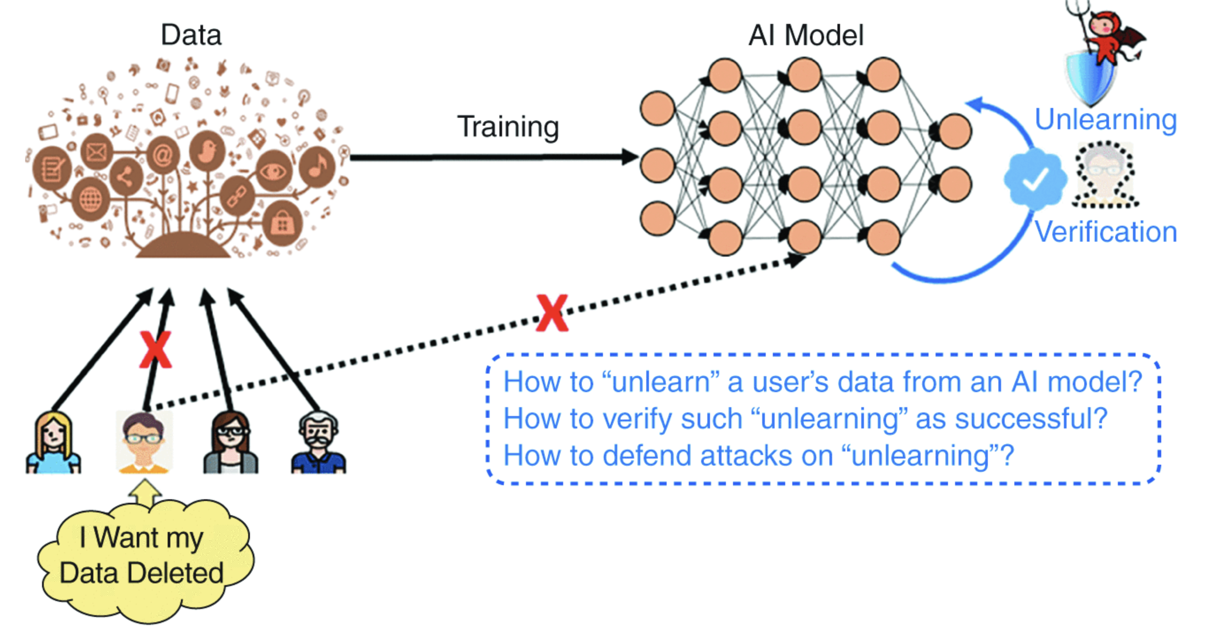
Primary Research Question
How do various machine unlearning mechanisms, including the choice of unlearning method, data modality, and data removal fraction, influence a model’s predictive uncertainty?​
Figure shows the need for Machine Unlearning
Notes:
Instruction:
Replace <BODY> with your own information.
Put your research question here.
This should be about one or two lines. The research question should fit the criteria for a good research question.

Slide 3
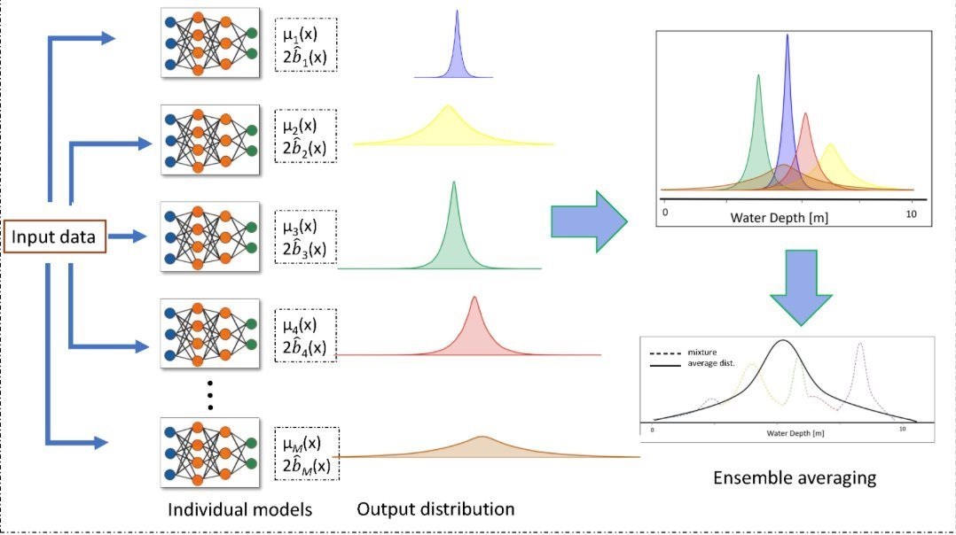
Primary Research Question
Figure shows Uncertainty Quantification using Deep Ensembles
Notes:
Instruction:
Replace <BODY> with your own information.
Put your research question here.
This should be about one or two lines. The research question should fit the criteria for a good research question.

Slide 4
Supporting Research Questions
1. How does unlearning different data modalities (e.g., instance-level, feature-level, or label-level) influence predictive uncertainty?​
2. How does varying the fraction of data being unlearned (e.g., 5%, 10%, 15%, 20%) impact predictive uncertainty?​
3. Does class-wise unlearning induce greater uncertainty drift than instance-wise unlearning?​
Notes:
Instruction:
Replace <BODY> with your own information.
Put your research question here.
This should be about one or two lines. The research question should fit the criteria for a good research question.

Slide 5
Related Work
Machine Unlearning
Machine unlearning is the process of removing data points from a trained machine learning model without needing to retrain the entire model.
It's vital when models are trained on data that is classified and private that needs to be removed later in the process
However, there are many challenges with this, like maintaining model accuracy, ensuring complete data removal and computational cost.
There's two kinds of unlearning : exact and approximate unlearning
Notes:
Replace <BODY …. > with your own information.
1. Put your first related work. You can use more pages. However, ensure that each page is not too cluttered with lengthy text.
You can use a bullet point. You do not need to put an entire sentence.
Keep the presentation visually appealing.
2. Cite the reference using the first author’s last name and year, such as [Tavanapong et al., 2024] , in the slide where it is most appropriate. For instance, after the first bullet point.
Some people cite it using a footnote to show the entire publication information. Some people place an image of the publication information in the top right corner.

Slide 6
Related Work
Uncertainty Quantification
Uncertainty Quantification measures how confident a model is in its predictions and turns it into a numerical value or probability.
This is important because it establishes trustworthiness in models which is crucial for industries like healthcare, finance, and autonomous driving.
Key Idea: A good model assigns high confidence to correct predictions and low confidence to uncertain ones.
Notes:
Replace <BODY …. > with your own information.
1. Put your first related work. You can use more pages. However, ensure that each page is not too cluttered with lengthy text.
You can use a bullet point. You do not need to put an entire sentence.
Keep the presentation visually appealing.
2. Cite the reference using the first author’s last name and year, such as [Tavanapong et al., 2024] , in the slide where it is most appropriate. For instance, after the first bullet point.
Some people cite it using a footnote to show the entire publication information. Some people place an image of the publication information in the top right corner.
.

Slide 7
Experimental Design
Dataset(s)
CIFAR-10 → general image classification benchmark.
CIFAR-10 dataset: Contains 60000 32x32 color images across 10 different classes. ​There are 50000 images for training and 10000 for testing.​ CIFAR-10 → RGB (3-channel)
Notes:
Instruction:
Descriptive statistics of your datasets, e.g., #of images/text documents, #questions per image/document,
Show some examples of data such as questions and answers

Slide 8
Experimental Design
Dataset(s)
MedMNIST → medical imaging classification where performance impacts real clinical settings.
MedMNIST: Has a collection of 10 pre-processed medical open datasets. These include Pathology, Chest X-Ray, Dermatoscope, OCT, and Abdominal CTs.​
DermaMNIST: Has 7 classes of 28x28 images, has 10015 images
Data Modality: Dermatoscope
Notes:
Instruction:
Descriptive statistics of your datasets, e.g., #of images/text documents, #questions per image/document,
Show some examples of data such as questions and answers

Slide 9
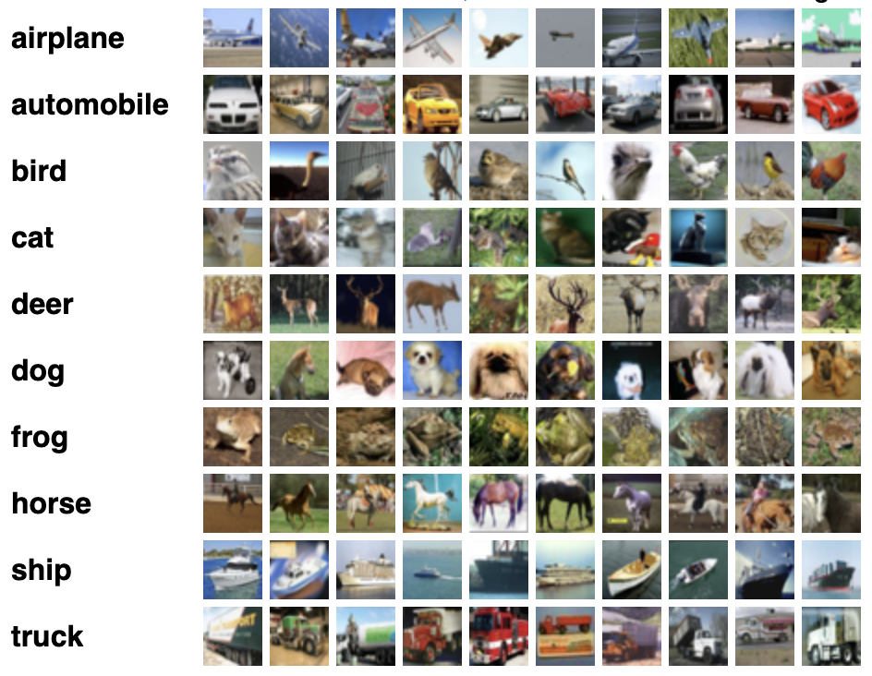
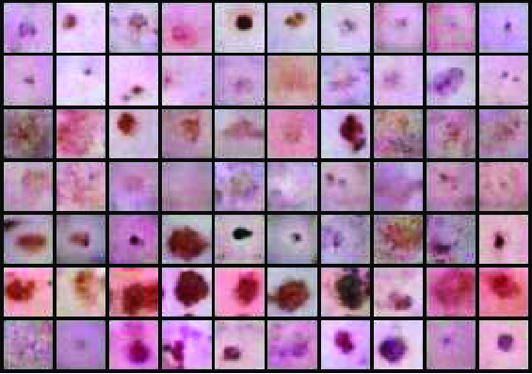
Experimental Design
Dataset(s)
​
DERMAMNIST
CIFAR-10
Notes:
Instruction:
Descriptive statistics of your datasets, e.g., #of images/text documents, #questions per image/document,
Show some examples of data such as questions and answers

Slide 10
Experimental Design
We use a Convolutional Neural Network (CNN) as the backbone model for all experiments.
Techniques compared:
Unlearning Methods: SISA, First-Order, and Fine-Tuning.
Uncertainty Quantification Techniques:
Deep Ensembles
Softmax
Temperature Scaling
Monte Carlo Dropout
Evaluation Metrics
Accuracy (for classification and unlearning performance)
Expected Calibration Error (Measures the confidence of a model)
Brier Score (measures calibration + prediction quality)
Prediction Time (for unlearning performance)
Notes:
Instruction:
Describe evaluation metrics used: such as accuracy, etc.
The machine learning models or LLMs used
Statistical tests if any, to validate the statistical significance of the findings

Slide 11
Experimental Design
We want to determine if the differences we observe are real or just noise from random seeds.
Statistical test:
We use a simple comparison test across three repeated runs to see whether the changes, after applying each unlearning method, are real or just due to randomness.
These tests are done separately for each dataset, each unlearning method, and uncertainty quantification method.
Why we use these statistical tests:
Neural networks don’t produce identical results every training run.
A metric change could be noise in the data set, random starting point of training data, random ordering of training data, etc.
This is why we need to test the model multiple times and come to conclusions after looking at all the results.
Notes:
Instruction:
Replace <BODY …. > with your own information.
Show plots (e.g., line, bar charts) comparing the performance of different models
The plots must have an X-axis title, a Y-axis title, and legends that are clearly visible. Text is clearly visible.
The plots must contain information to answer the research questions.
4. You can have multiple pages of experimental results

Slide 12
Experimental Results
Question 1: Do unlearning methods produce different uncertainty?
Method | Data Set | Accuracy | Unlearning Time(s) | Prediction Time(s)
Fine-Tuning | Unlearn class | 0.6970 ± 0.0255 | 48.88 | 2.1
Fine-Tuning | Retain class | 0.6704 ± 0.0061 | 48.88 | 2.1
First-Order | Unlearn class | 0.6847 ± 0.0176 | 50.28 | 2.25
First-Order | Retain class | 0.6714 ± 0.0008 | 50.28 | 2.25
SISA | Unlearn class | 0.6800 | 293.3 | 12.59
SISA | Retain class | 0.6786 | 293.3 | 12.59
Findings:
None of the methods were extremely effective at machine unlearning, as all techniques—including First Order and Fine Tuning—failed to drive the accuracy of the unlearned data significantly below the model's overall utility level of approximately 68%.
SISA was the most robust as it achieved the highest accuracy on the unlearned class and the retained classes, showing that it protects utility even though it might potentially hinder the unlearning process.
Fine-Tuning is the most computationally efficient unlearning technique, requiring the least unlearning time (48.88 seconds), while the SISA framework incurs the highest cost (293.3 seconds) due to its dependency on training multiple model shards.
Notes:
Instruction:
Replace <BODY …. > with your own information.
Show plots (e.g., line, bar charts) comparing the performance of different models
The plots must have an X-axis title, a Y-axis title, and legends that are clearly visible. Text is clearly visible.
The plots must contain information to answer the research questions.

Slide 13
Experimental Results
Method | Data Set | ECE Score | Brier Score
Fine-Tuning | Unlearn class | 0.0319 ± 0.0043 | 0.4370 ± 0.0050
Fine-Tuning | Retain class | 0.305 ± 0.0137 | 0.4480 ± 0.0050
First-Order | Unlearn class | 0.0310± 0.0090 | 0.4432 ± 0.0201
First-Order | Retain class | 0.0298 ± 0.0024 | 0.4452 ± 0.009
SISA | Unlearn class | 0.0289 | 0.4323
SISA | Retain class | 0.0417 | 0.4437
Findings:
SISA provides the best uncertainty estimates, showing lower ECE and Brier Scores than individual unlearning methods for both retained and unlearned data.
The unlearning methods failed to achieve complete data privacy using uncertainty metrics as the scores very similar with retain and unlearn class.
Utility was compromised by poor calibration loss of and First-Order, as the high uncertainty observed in Fine-Tuning and First-Order was not selective and also affected the retained data, indicating a general loss of model confidence.
Notes:
Instruction:
Replace <BODY …. > with your own information.
Show plots (e.g., line, bar charts) comparing the performance of different models
The plots must have an X-axis title, a Y-axis title, and legends that are clearly visible. Text is clearly visible.
The plots must contain information to answer the research questions.

Slide 14
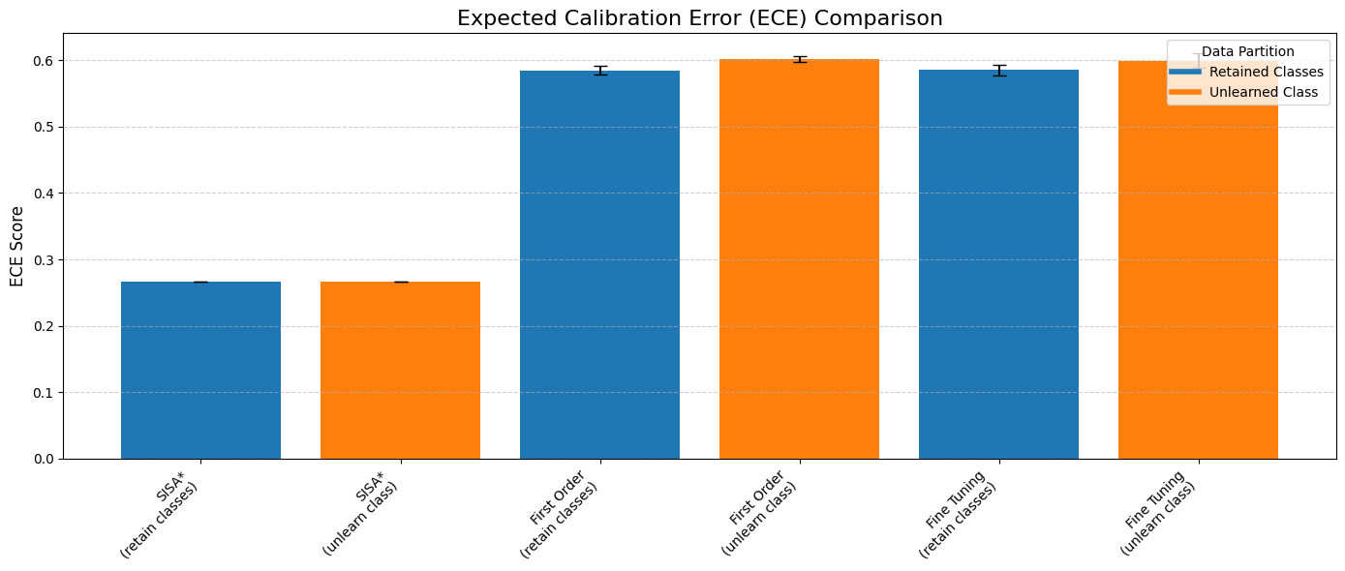
Experimental Results
Question 1:
Notes:
Instruction:
Replace <BODY …. > with your own information.
Show plots (e.g., line, bar charts) comparing the performance of different models
The plots must have an X-axis title, a Y-axis title, and legends that are clearly visible. Text is clearly visible.
The plots must contain information to answer the research questions.

Slide 15
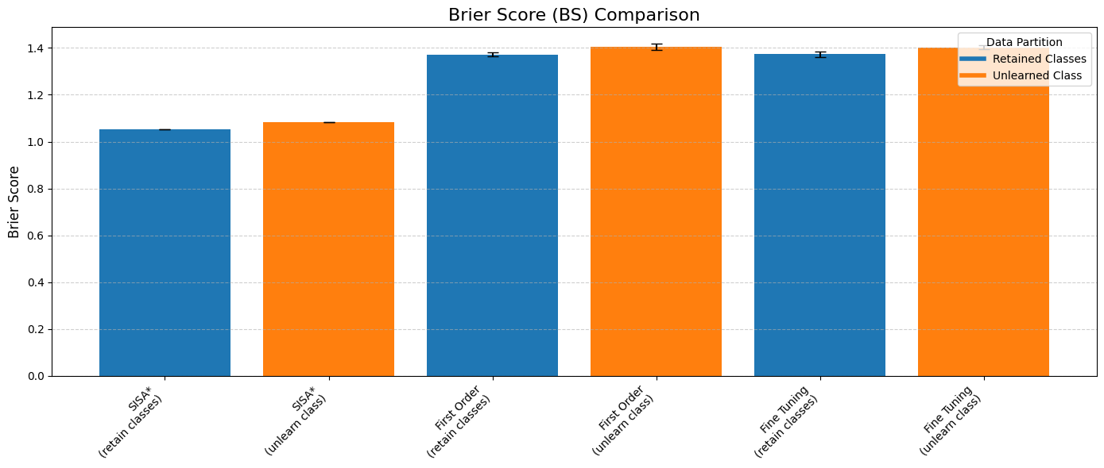
Experimental Results
Notes:
Instruction:
Replace <BODY …. > with your own information.
Show plots (e.g., line, bar charts) comparing the performance of different models
The plots must have an X-axis title, a Y-axis title, and legends that are clearly visible. Text is clearly visible.
The plots must contain information to answer the research questions.

Slide 16
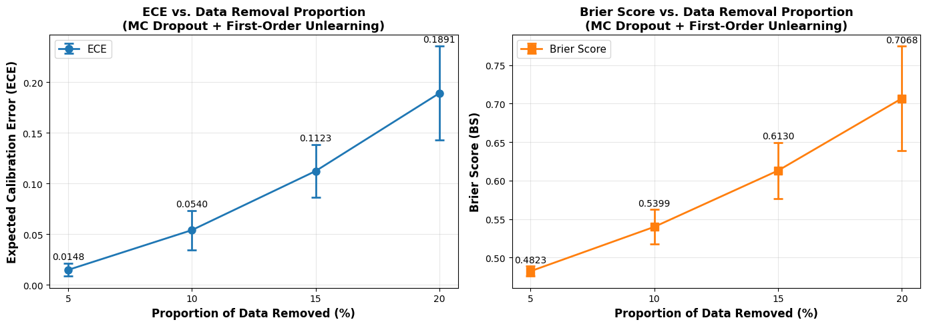
Experimental Results
Question 2: Does removing more data increase uncertainty consistently?
Unlearning Method: First-order based
Uncertainty Method: MC Dropout
Results averaged over 3 runs per proportion of data removed (5%, 10%, 15%, 20%)
Findings:
Predictive Uncertainty increases consistently as more training data is unlearned (both ECE and BS increase).
Larger unlearning proportions significantly degrade calibration and model accuracy.
Proportion | ECE (mean ± std) | Brier Score (mean ± std)
5% | 0.0148 ± 0.0063 | 0.4823 ± 0.0066
10% | 0.0540 ± 0.0195 | 0.5399 ± 0.0227
15% | 0.1123 ± 0.0258 | 0.6130 ± 0.0367
20% | 0.1891 ± 0.0463 | 0.7068 ± 0.0677
Table shows results compiled after experiment runs
Figure shows ECE and Brier Score vs Proportions of data removed. Growth is super-linear (mildly accelerating)
Notes:
Instruction:
Replace <BODY …. > with your own information.
Show plots (e.g., line, bar charts) comparing the performance of different models
The plots must have an X-axis title, a Y-axis title, and legends that are clearly visible. Text is clearly visible.
The plots must contain information to answer the research questions.

Slide 17
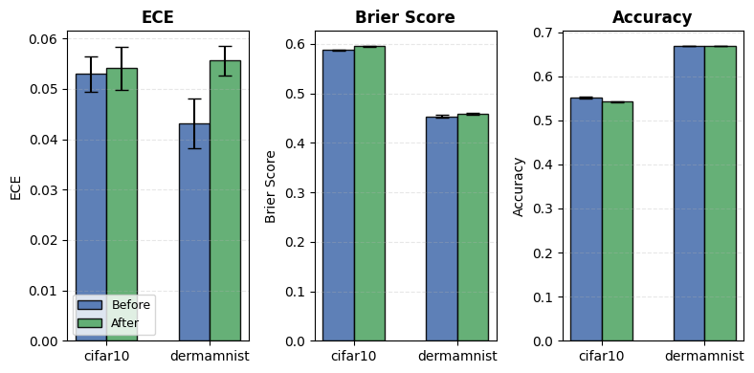
Experimental Results
Question 3: Do these effects depend on dataset type (general vs. medical images)?
We removed 5% of data using Deep Ensembles and SISA on CIFAR-10 and DERMAMNIST, running each setup 3 times and reporting ECE/Brier mean ± STD.
Findings:
There is a minimal drop in accuracy after in both the datasets unlearning.
DermaMNIST showed a significantly larger ECE degradation after unlearning, likely due to its much smaller training dataset (10,000 images vs. 60,000 for CIFAR-10).
The Brier Score (overall prediction quality) also worsens slightly for both datasets.
Dataset | Before Unlearning | After Unlearning
CIFAR-10 | ECE: 0.0529 ± 0.0035 BS: 0.5873 ± 0.0017 Accuracy: 0.5513 ± 0.0021 | ECE: 0.0541 ± 0.0042 BS: 0.5951 ± 0.0012 Accuracy: 0.5419 ± 0.002
DermaMNIST | ECE: 0.0431 ± 0.0049 BS: 0.4536 ± 0.0026 Accuracy: 0.6690 ± 0.0002 | ECE: 0.0556 ± 0.0029 BS: 0.4585 ± 0.0016 Accuracy: 0.6688 ± 0.000

Slide 18
Experimental Results
Question 4: How does unlearning different data modalities affect predictive uncertainty?
Unlearning method: First-order based
Uncertainty method: Temperature Scaling
5% unlearned per data modality (Instances, Gaussian Noises, Modified Labels) and results averaged over 3 runs.
Findings:
Unlearning label modified data results in the highest uncertainty with worse ECE and BS compared to other modalities.
Instance and Gaussian Noise have similar and mild impacts on uncertainty, which indicates that not all modalities have the same effect on model confidence.
Modality | ECE (mean ± std) | Brier Score (mean ± std)
Instances | 0.0205 ± 0.0019 | 0.5182 ± 0.0284
Gaussian Noises | 0.0205 ± 0.0038 | 0.5253 ± 0.0337
Modified Labels | 0.0402 ± 0.0199 | 0.5989 ± 0.0546
Table shows the effects of unlearning 5% of different data modalities on model confidence and predictive uncertainty

Slide 19
Conclusion and Future Work
We find that machine unlearning has a substantial negative impact on predictive uncertainty, resulting in significantly increased uncertainty errors after unlearning.
  The First-Order method is most effective at unlearning, while the SISA framework, though the most time-consuming, provides the highest degree of predictive utility and the most reliable uncertainty estimates for remaining data.
  The uncertainty error increment becomes more pronounced as the amount of data to be unlearned grows.
  Unlearning has an impact on both standard and real-world datasets. However, DermaMNIST showed larger error increments, potentially due to its smaller training dataset size.
  Unlearning label modified data results in the highest uncertainty with worse ECE and BS compared to other modalities. Instances and Gaussian Noises have similar and mild impacts on predictive uncertainty.
Future research should focus on developing more robust uncertainty quantification methods that remain reliable under unlearning requests for privacy protection.
Notes:
Replace <BODY …. > with your own information.
Instruction:
This page includes at least three related works, two of which are from what you presented.
The format of the reference can follow the IEEE format. Examples are below.
For each author, the initial of the first name is used, followed by the last name of the author. Notice that the book has a volume and a publisher in addition to the page number and year of publication.
See [8] for an example of a reference for a conference. Make sure your reference is a peer-reviewed publication. You can use Zotero to generate the IEEE reference by selecting a paper. Right click. Choose “Create Bibliography from Item”. Choose IEEE for the Citation Style and for the output choose “Copy to Clipboard”. Then paste it on this PowerPoint slide.
[1] G. Eason, B. Noble, and I. N. Sneddon, “On certain integrals of Lipschitz-Hankel type involving products of Bessel functions,” Phil. Trans. Roy. Soc. London, vol. A247, pp. 529–551, April 1955. (references)
[2] J. Clerk Maxwell, A Treatise on Electricity and Magnetism, 3rd ed., vol. 2. Oxford: Clarendon, 1892, pp.68–73.
[3] I. S. Jacobs and C. P. Bean, “Fine particles, thin films and exchange anisotropy,” in Magnetism, vol. III, G. T. Rado and H. Suhl, Eds. New York: Academic, 1963, pp. 271–350.
[4] K. Elissa, “Title of paper if known,” unpublished.
[5] R. Nicole, “Title of paper with only first word capitalized,” J. Name Stand. Abbrev., in press.
[6] Y. Yorozu, M. Hirano, K. Oka, and Y. Tagawa, “Electron spectroscopy studies on magneto-optical media and plastic substrate interface,” IEEE Transl. J. Magn. Japan, vol. 2, pp. 740–741, August 1987 [Digests 9th Annual Conf. Magnetics Japan, p. 301, 1982].
[7] M. Young, The Technical Writer’s Handbook. Mill Valley, CA: University Science, 1989.
[8] L. Bourtoule et al., “Machine Unlearning,” in 2021 IEEE Symposium on Security and Privacy (SP), 2021, pp. 141–159. doi: 10.1109/SP40001.2021.00019.

Slide 20
References
Machine Unlearning
  Bourtoule, Lucas, et al. "Machine unlearning." 2021 IEEE symposium on security and privacy (SP). IEEE, 2021.
Uncertainty Quantification
  Lakshminarayanan, Balaji, Alexander Pritzel, and Charles Blundell. “Simple and Scalable Predictive Uncertainty Estimation Using Deep Ensembles.” Advances in Neural Information Processing Systems (NeurIPS 2017), vol. 30, Curran Associates, Inc., 2017.
  Guo, Chuan, et al. "On calibration of modern neural networks." International conference on machine learning. PMLR, 2017.
Notes:
Replace <BODY …. > with your own information.
Instruction:
This page includes at least three related works, two of which are from what you presented.
The format of the reference can follow the IEEE format. Examples are below.
For each author, the initial of the first name is used, followed by the last name of the author. Notice that the book has a volume and a publisher in addition to the page number and year of publication.
See [8] for an example of a reference for a conference. Make sure your reference is a peer-reviewed publication. You can use Zotero to generate the IEEE reference by selecting a paper. Right click. Choose “Create Bibliography from Item”. Choose IEEE for the Citation Style and for the output choose “Copy to Clipboard”. Then paste it on this PowerPoint slide.
[1] G. Eason, B. Noble, and I. N. Sneddon, “On certain integrals of Lipschitz-Hankel type involving products of Bessel functions,” Phil. Trans. Roy. Soc. London, vol. A247, pp. 529–551, April 1955. (references)
[2] J. Clerk Maxwell, A Treatise on Electricity and Magnetism, 3rd ed., vol. 2. Oxford: Clarendon, 1892, pp.68–73.
[3] I. S. Jacobs and C. P. Bean, “Fine particles, thin films and exchange anisotropy,” in Magnetism, vol. III, G. T. Rado and H. Suhl, Eds. New York: Academic, 1963, pp. 271–350.
[4] K. Elissa, “Title of paper if known,” unpublished.
[5] R. Nicole, “Title of paper with only first word capitalized,” J. Name Stand. Abbrev., in press.
[6] Y. Yorozu, M. Hirano, K. Oka, and Y. Tagawa, “Electron spectroscopy studies on magneto-optical media and plastic substrate interface,” IEEE Transl. J. Magn. Japan, vol. 2, pp. 740–741, August 1987 [Digests 9th Annual Conf. Magnetics Japan, p. 301, 1982].
[7] M. Young, The Technical Writer’s Handbook. Mill Valley, CA: University Science, 1989.
[8] L. Bourtoule et al., “Machine Unlearning,” in 2021 IEEE Symposium on Security and Privacy (SP), 2021, pp. 141–159. doi: 10.1109/SP40001.2021.00019.

Slide 21
Questions?
Notes:
This slide is to trigger the audience to ask questions. Some people put a QR code to their contact information such as a LinkedIn account.

